Slide 1

LIST OF AWARDS

Slide 2


Maruti Suzuki - Special Support Award for the year 2024-25

Slide 3
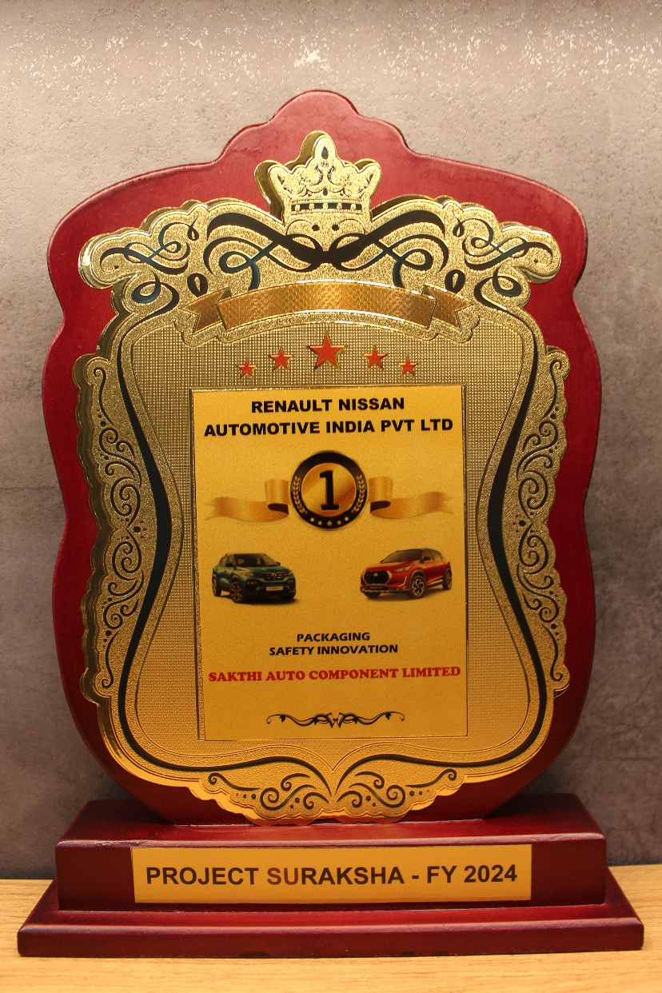
Renault Nissan – Packaging Safety Innovation Award 2024

Slide 4
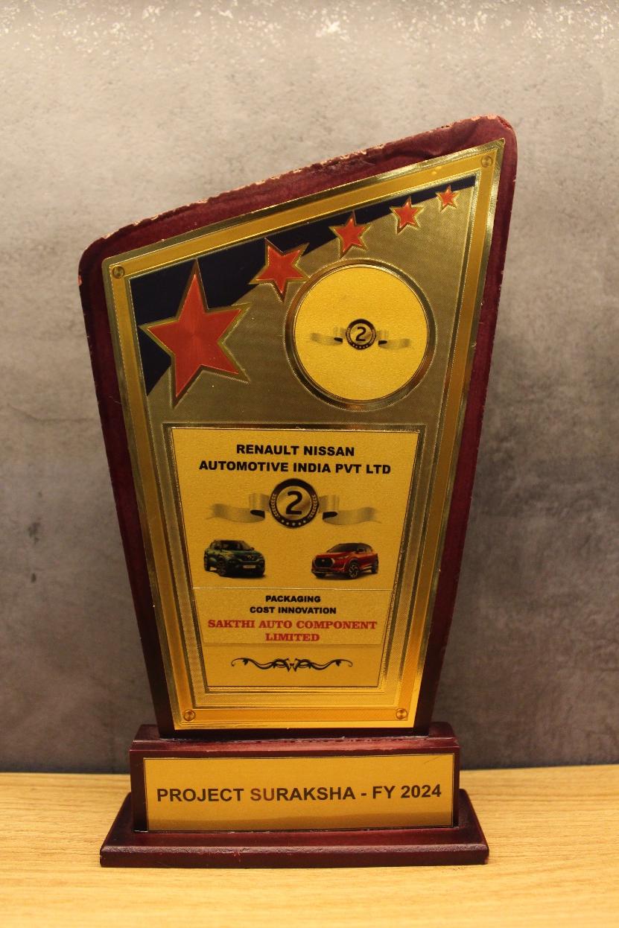
Renault Nissan – Packaging Cost Innovation Award 2024

Slide 5

ILJIN – SGA Competition Award 2024

Slide 6
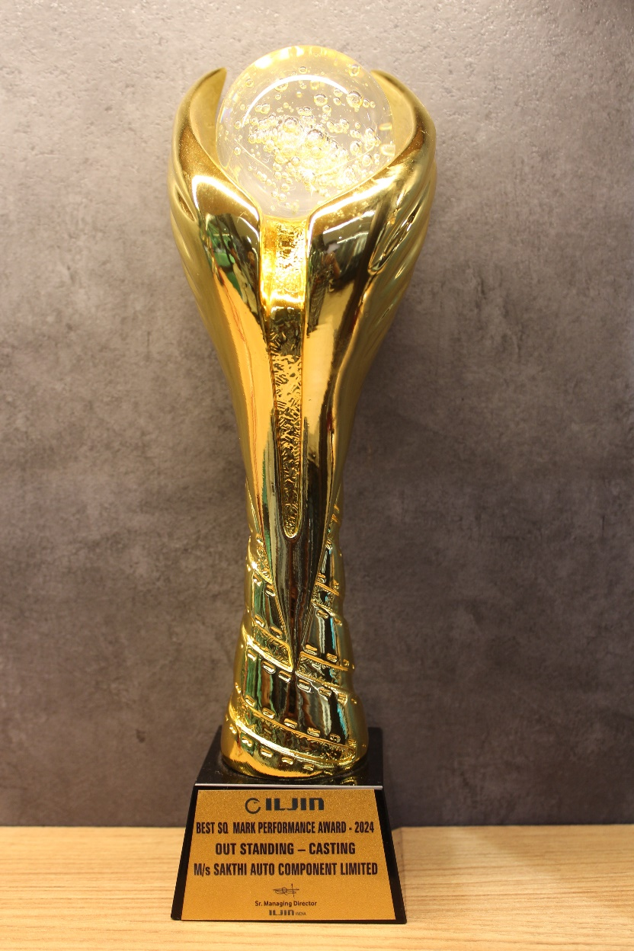
ILJIN – Outstanding Award 2024 - Casting

Slide 7
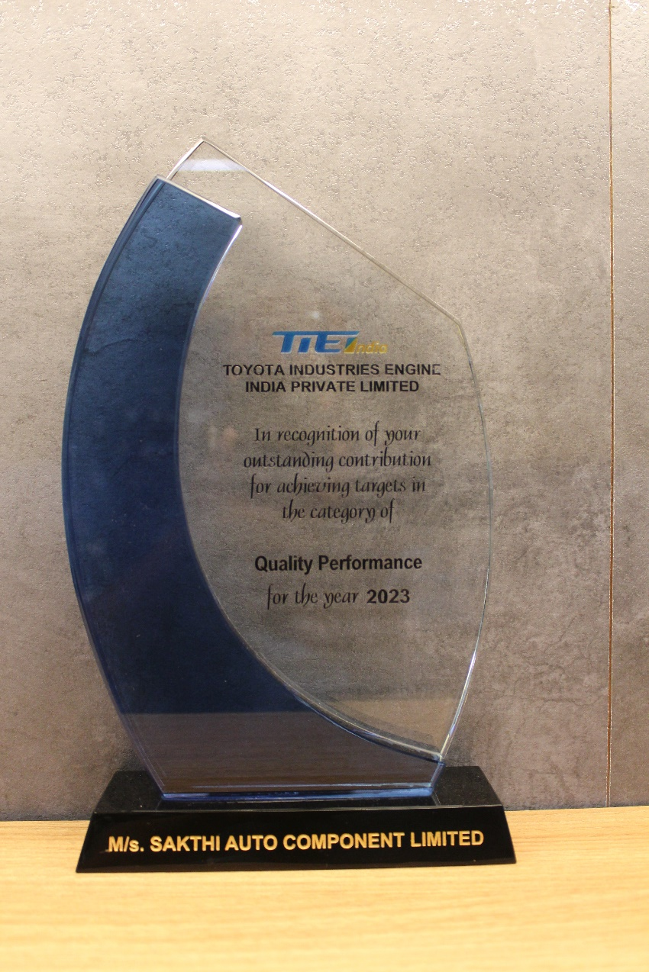
TIEI – Quality Performance Award - 2023

Slide 8
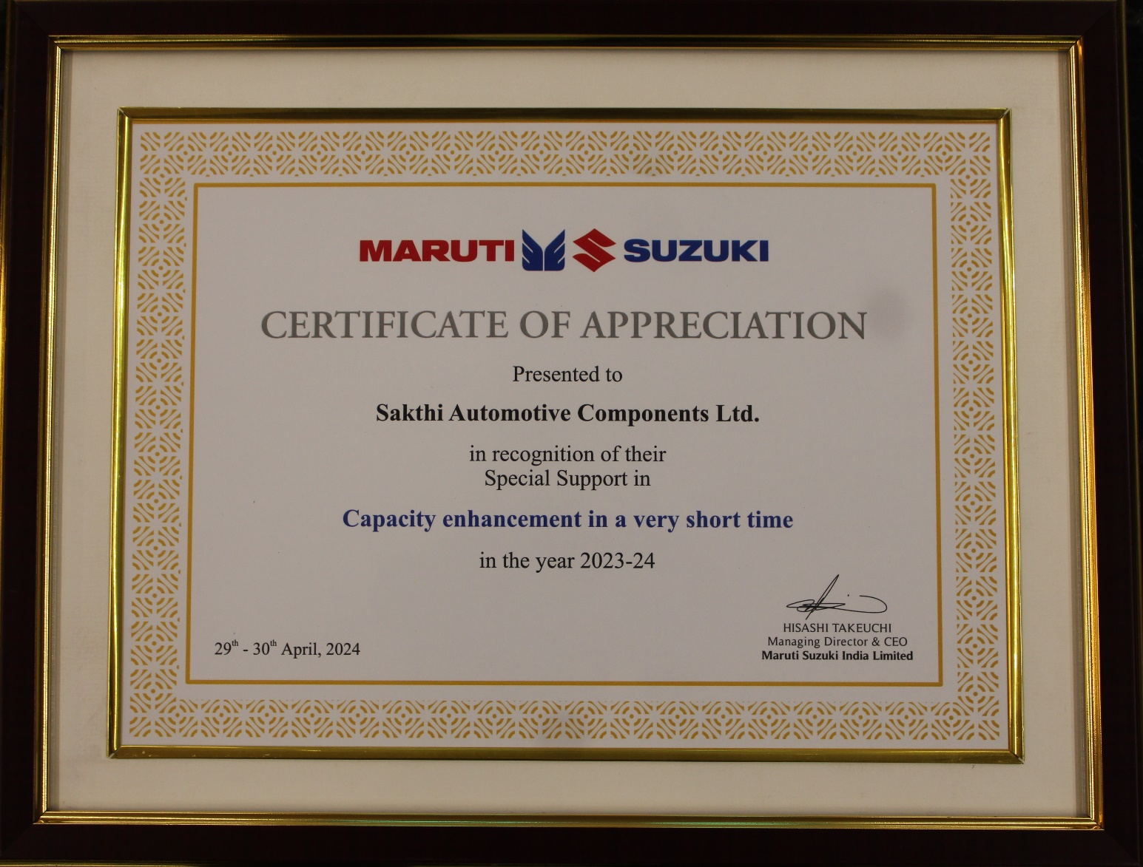
Maruti Suzuki - Special Support Award for the year 2023-24

Slide 9
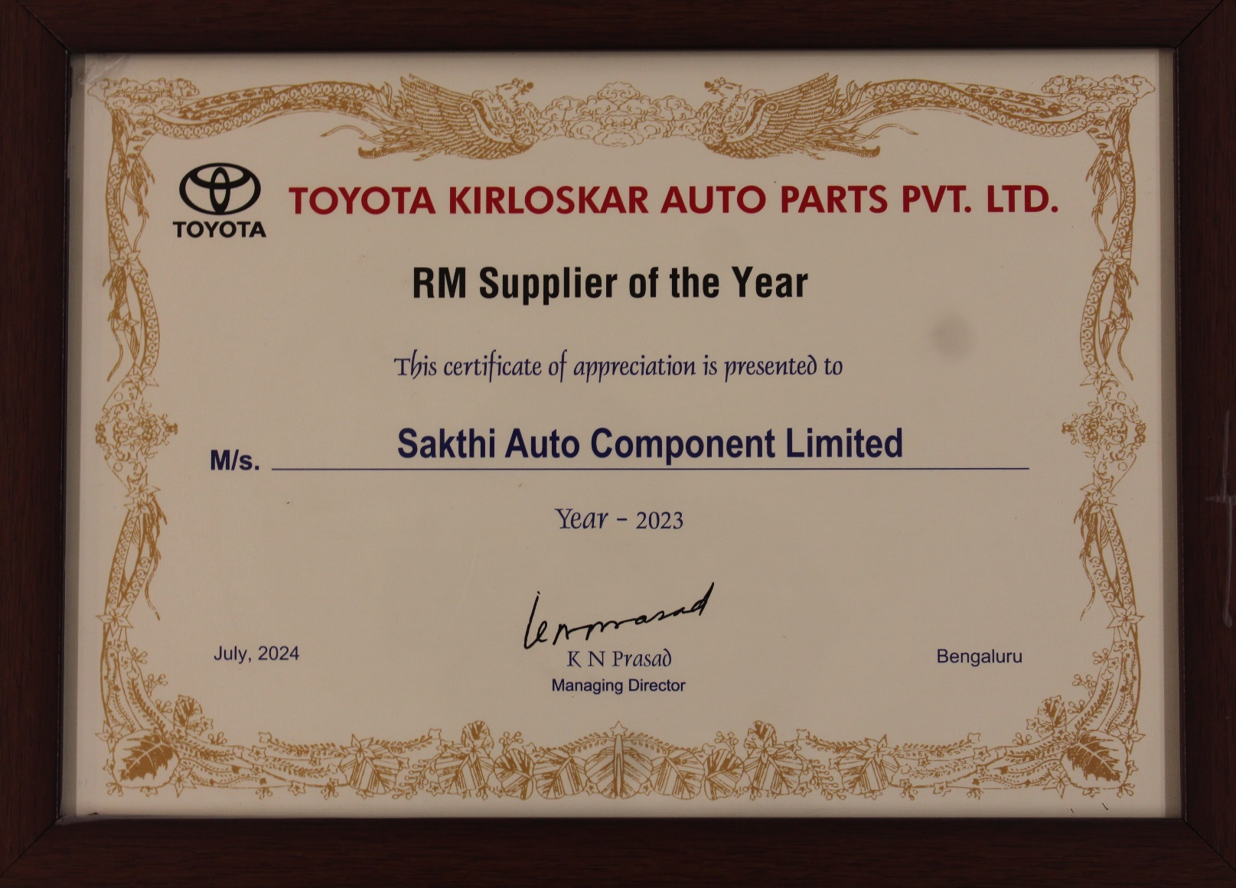
TOYOTA – RM Supplier of the year 2023

Slide 10
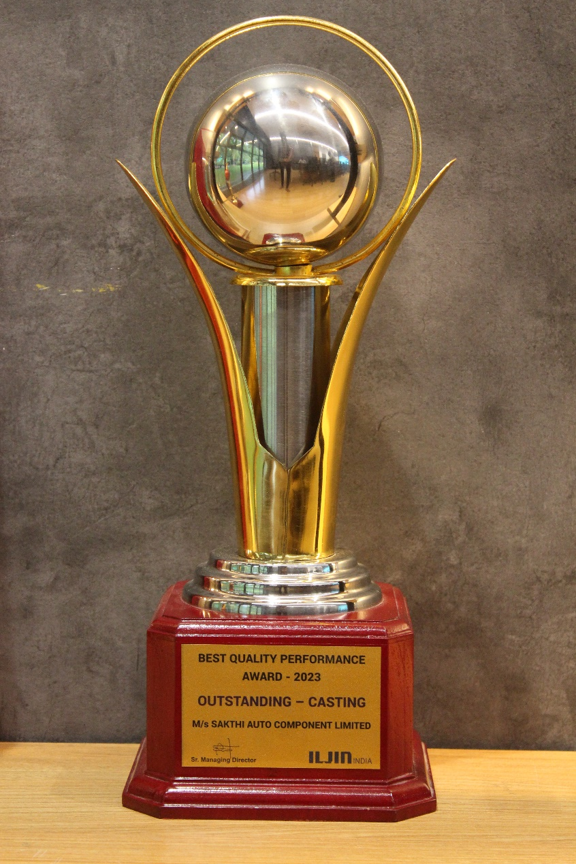
ILJIN – Best Quality Performance Award 2023

Slide 11
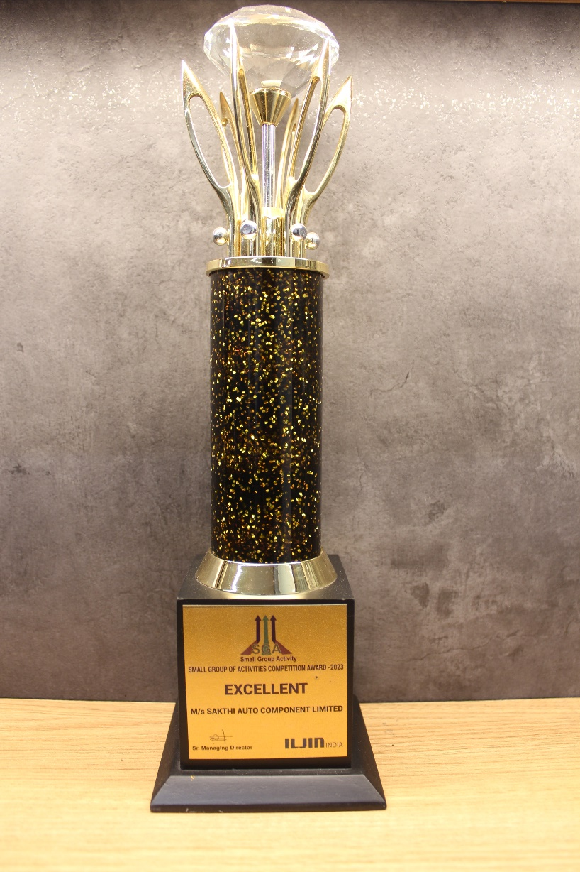
ILJIN – SGA Competition Award 2023

Slide 12
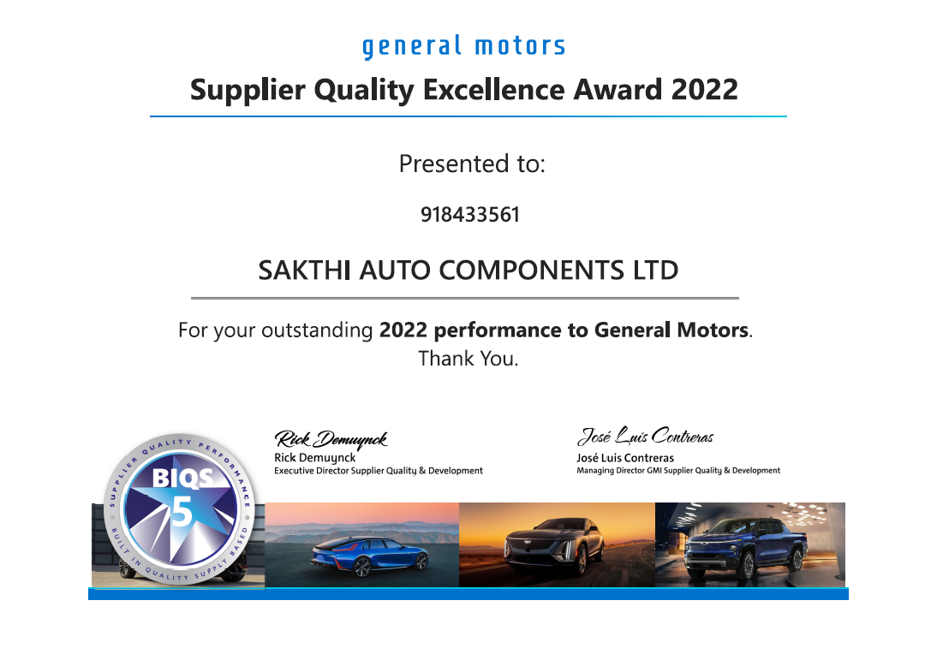
GM – Supplier Quality Excellence Award - 2022

Slide 13
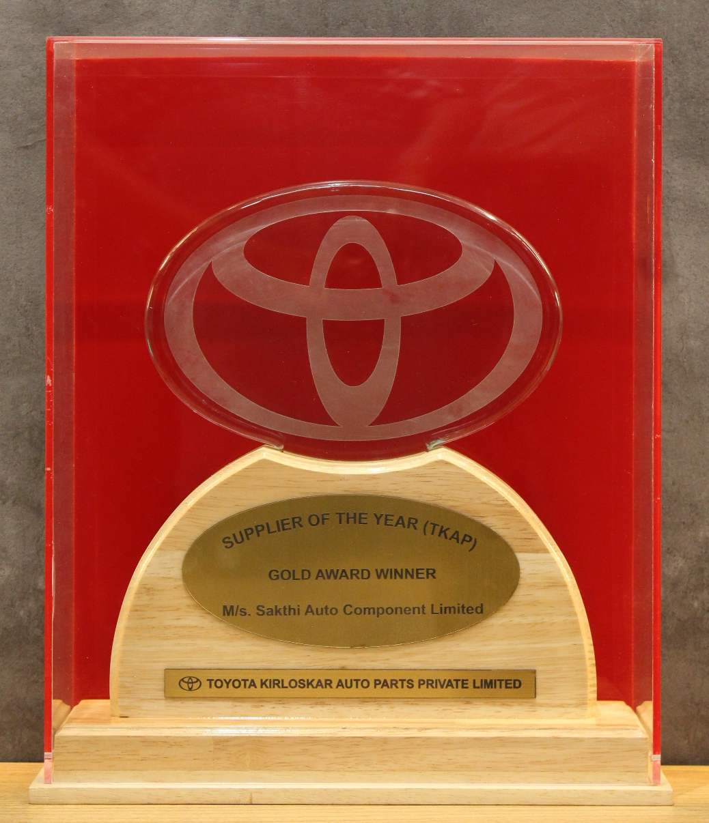
TOYOTA – Gold Award Winner

